Slide 1
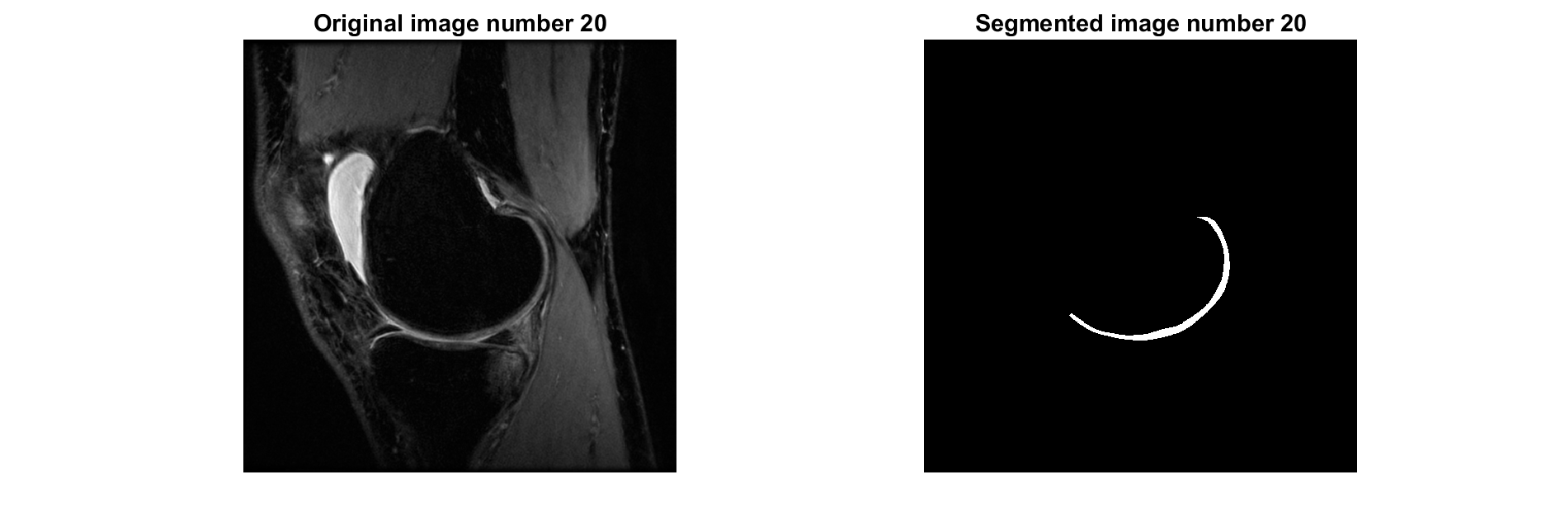
Trying flat_2D_cartilage_warping()
Single cartilage
Two options for the boundary splines:
Using bwboundaries()
Fake – arcs with fixed radius and uniform phase

Slide 2
flat_2D_cartilage_warping() options
noffsets (default=5): Since cartilage flattening is predominantly done for texture analysis using gray-level co-occurrence matrices (GLCM), this is a scalar that tells the program the number of offsets to be used in GLCM. The purpose of noffsets is for cases where the cartilage is split into multiple segments in a single slice so we can separate the flattened images accordingly.
isboneref (default=1)
isboneref=1: The bone-cartilage interface is the reference for flattening, i.e. the bone-cartilage interface will look like a straight line.
isboneref=0: The articular surface is the reference for flattening, i.e. the articular surface will look like a straight line.
T2Th (default=[]): It is a scalar indicating that all Ima values greater than T2Th should be cropped to T2Th. T2Th=[] does not crop Ima.
matching_method (MM) (default=3)
1 - Minimum Euclidean distances
2 - Normal vectors
3 - Laplacian equation

Slide 3
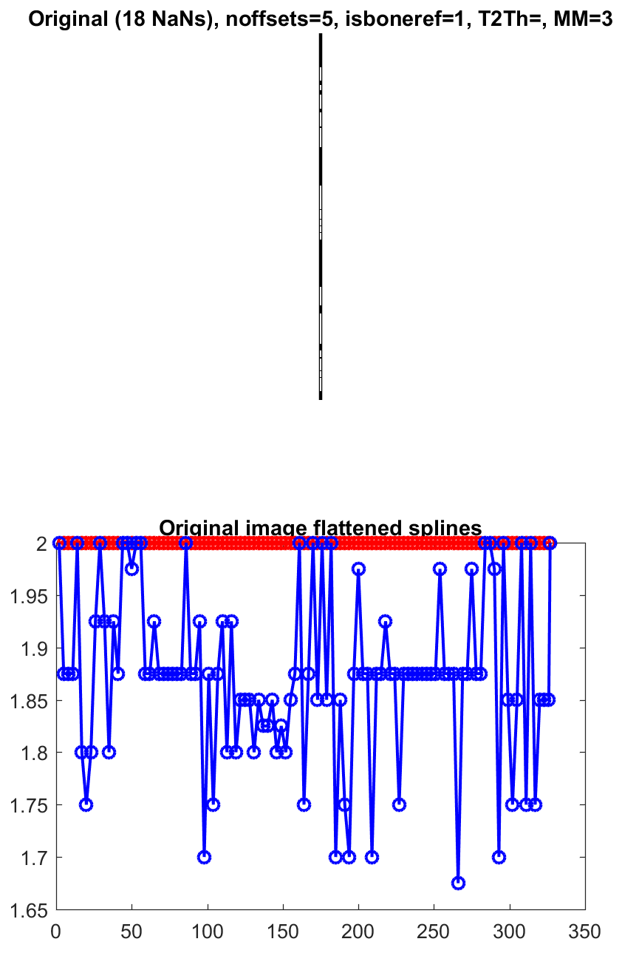
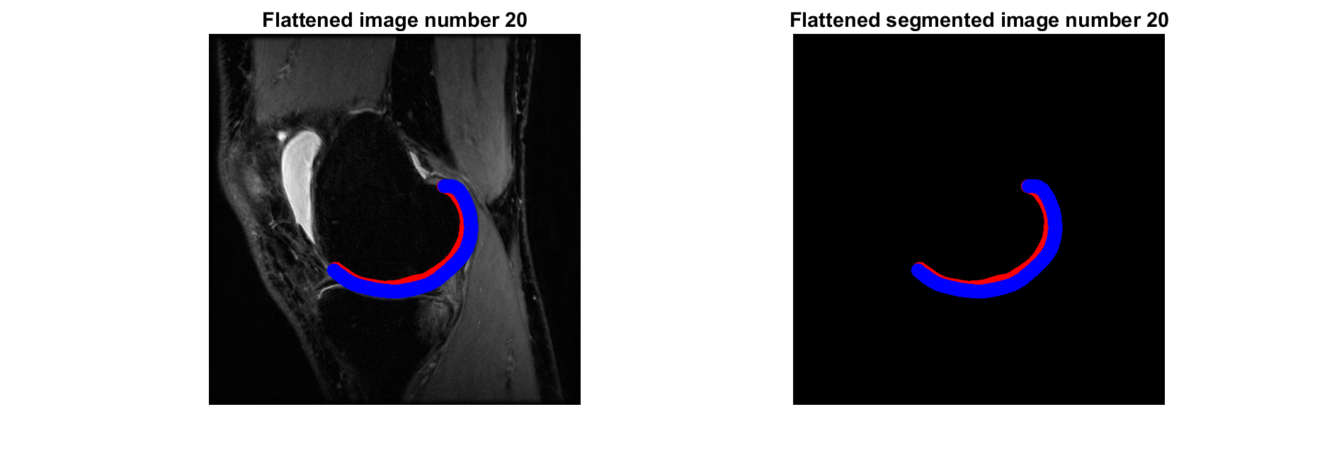
MM=3 – singular, NaNs
Warning: Warning: Matrix is close to singular or badly scaled.
> In getFornefettcoefficients (line 36)
Playing with function options didn’t change it (except MM)

Slide 4
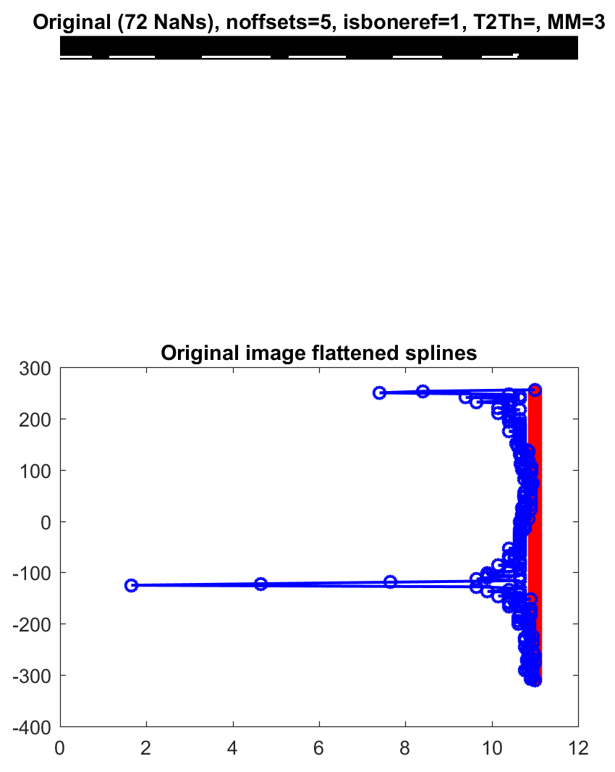
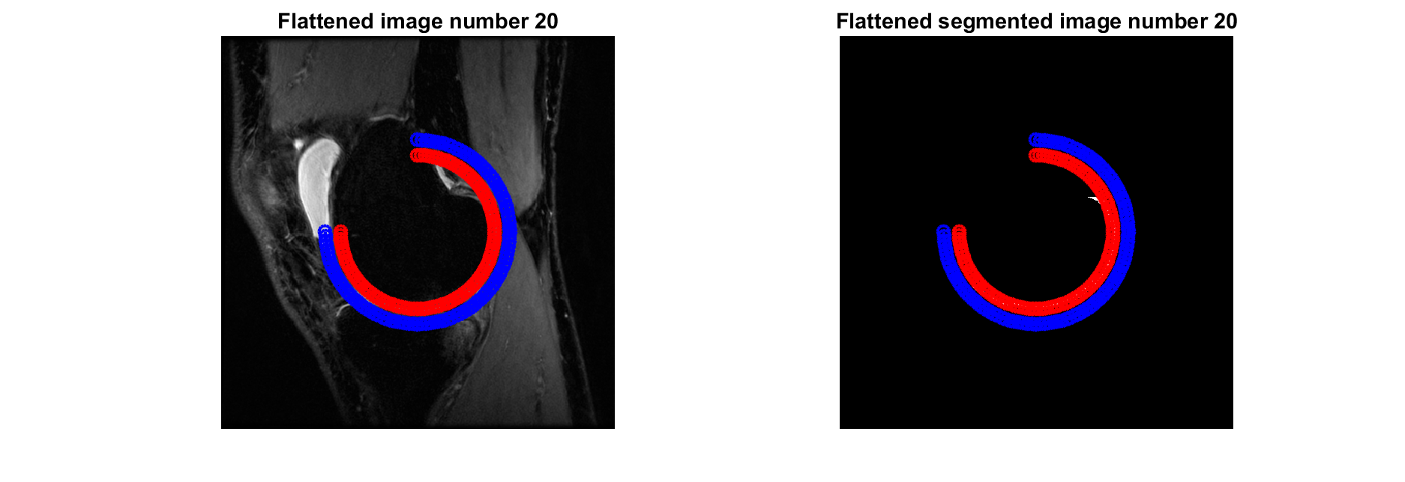
MM=3, fake splines
Same result – singularity and NaNs

Slide 5
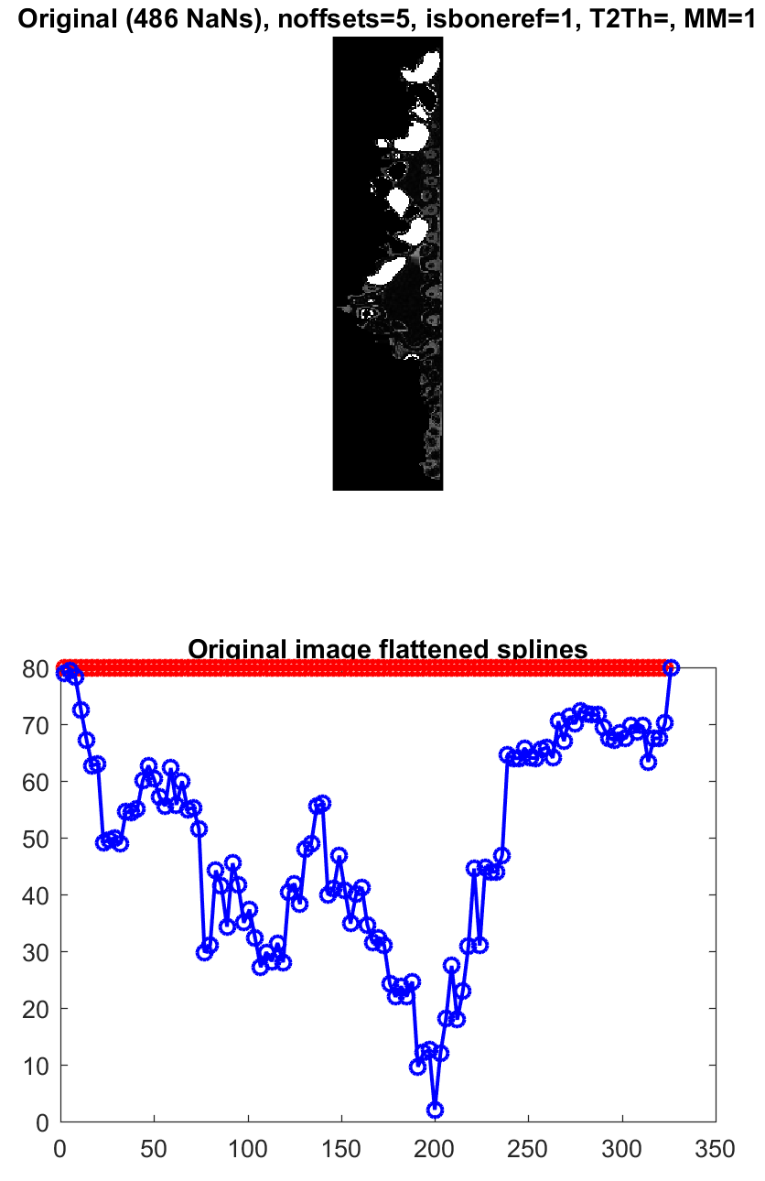
MM=1
34min on my laptop
14min on a server

Slide 6
MM=2
Worked for hours w/o finishing…

